Slide 1
Brandy K. Nicholson, LPC NCC RPT
School Counselor, HCES 2020

Slide 2
What is the “right” career for you?
Brandy K. Nicholson, LPC NCC RPT
School Counselor, HCES 2020

Slide 3
Who are you?
Where are you going?
How are you going to get there?
Brandy K. Nicholson, LPC NCC RPT
School Counselor, HCES 2020

Slide 4
What is RIASEC?
Realistic
Realistic people tend to have athletic interests, prefer to work with objects, machines, tools, plants or animals, and like to be outdoors.
Investigative
Investigative people like to observe, learn, investigate, analyze, and solve problems.
Artistic
Artistic people like to work in unstructured situations using their imagination and creativity.
Social
Social people like to work with people to inspire, inform, help, train or cure them.
Enterprising
Enterprising people like to work with people to influence, persuade and lead them, and to achieve organizational or financial goals.
Conventional
Conventional people like to work with information, carry out detailed tasks, and have clerical or numerical interests.
http://www.careeronestop.org/Toolkit/Careers/interest-assessment-riasec-scores.aspx?answers=311522111544234421132431123411&lang=en
Brandy K. Nicholson, LPC NCC RPT
School Counselor, HCES 2020

Slide 5
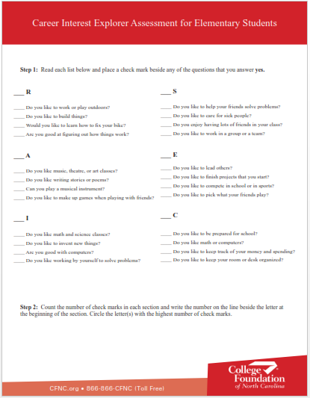
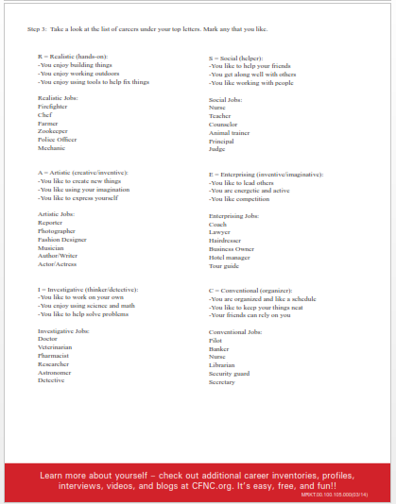
1st grade - Start your assessment . . .
Who are you?
Brandy K. Nicholson, LPC NCC RPT
School Counselor, HCES 2020

Slide 6
2nd grade - Start your assessment . . .
Who are you?
Brandy K. Nicholson, LPC NCC RPT
School Counselor, HCES 2020

Slide 7
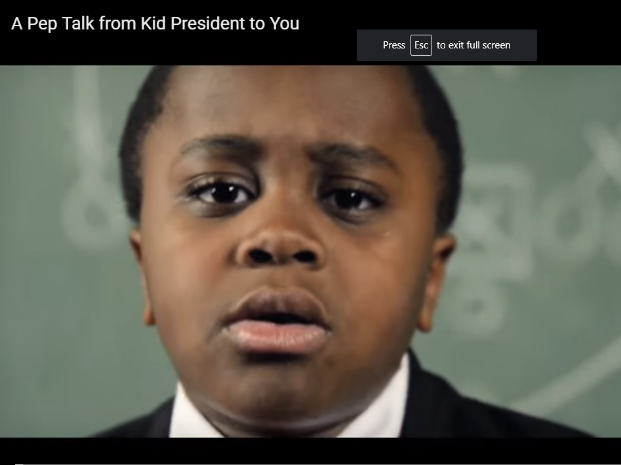
Where are you going?
https://www.ted.com/talks/kid_president_i_think_we_all_need_a_pep_talk
“Two roads diverged in a wood and I - I took the one less traveled by, and that has made all the difference.” Robert Frost
https://www.brainyquote.com/quotes/robert_frost_101324
Brandy K. Nicholson, LPC NCC RPT
School Counselor, HCES 2020

Slide 8
How are you going to get there?
17 Career Clusters
1. Agriculture, Food & Natural Resources
2. Architecture & Construction
3. Arts, A/V Technology & Communications
4. Business Management & Administration
5. Education & Training
6. Energy
7. Finance
8. Government & Public Administration
9. Health Science
10. Hospitality & Tourism
11. Human Services
12. Information Technology
13. Law, Public Safety, Corrections & Security
14. Manufacturing
15. Marketing
16. Science, Technology, Engineering & Mathematics
17. Transportation, Distribution & Logistics
Brandy K. Nicholson, LPC NCC RPT
School Counselor, HCES 2020

Slide 9
How are you going to get there?
3 clusters for 1st grade
Agriculture, Food & Natural Resources
In the Agriculture, Food, and Natural Resources cluster, you could raise plants and animals as sources for food and shelter. On the other hand, you could focus on selling and making products from plants and animals. These products include food, lumber, and fabrics. You might also provide advice and services that farmers and ranchers need to improve products. Another option in this cluster is to work to conserve natural resources and protect the environment.
Transportation, Distribution & Logistics
If you are interested in working in this cluster, you have three avenues. One is to move people and products by road, air, rail, or water. You would drive or pilot different means of transportation. The second is to repair and maintain the vehicles, trains, plains, and ships to keep people and products moving. The third option is to work behind the scenes to make sure the products and people get to the right place on time.
Law, Public Safety, Corrections & Security
If you are interested in working in this cluster, you have several options. One option is to guard the public by enforcing the law. Or you might provide fire protection and security. Another option is to provide legal services people who commit crimes.
Brandy K. Nicholson, LPC NCC RPT
School Counselor, HCES 2020

Slide 10
How are you going to get there?
3 clusters for 2nd grade
Arts, A/V Technology & Communications
In the Arts, Audio/Visual Technology, and Communications cluster, you have two avenues. One is to be the performer or artist. The other is to work behind the scenes to make the performance or publication happen. As a reporter, actor, or fine artist, you would use your creative talents. To assure that a concert or magazine is successful, you would use computers and sound equipment. The occupations in this cluster allow you to use your creativity, talent, and technical skills.
Health Science
In the Health Science cluster you would promote health and wellness or diagnose and treat injuries and disease. You could work directly with people. Or you could work in laboratories to get information used in research or diagnosis. Health service employees go to work at a variety of different sites. Some work in hospitals, offices, or laboratories. Others work on cruise ships, at sports arenas, or within communities.
Education & Training
In the Education and Training cluster, you would have the opportunity to guide and train young people. As a teacher, you could influence young lives. In addition, you could support the work of the classroom teacher as a counselor, librarian, or principal. If you are interested in working with adults, you could provide training to employees in a business. Each of these settings provides you with the chance to help people learn and improve their lives.
Brandy K. Nicholson, LPC NCC RPT
School Counselor, HCES 2020

Slide 11
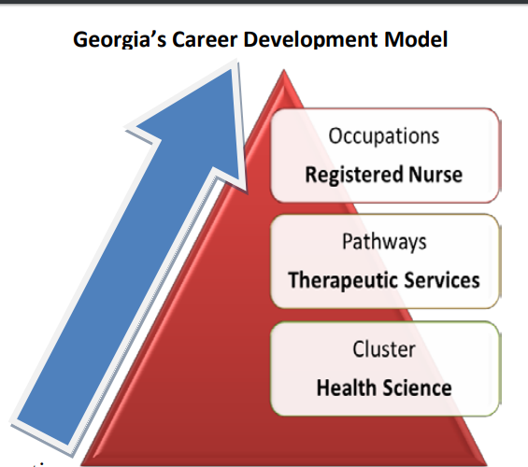
How are you going to get there?
Brandy K. Nicholson, LPC NCC RPT
School Counselor, HCES 2020

