Slide 1
Brandy K. Nicholson, LPC NCC RPT
School Counselor, HCES 2020

Slide 2
What is the “right” career for you?
Brandy K. Nicholson, LPC NCC RPT
School Counselor, HCES 2020

Slide 3
Who are you?
Where are you going?
How are you going to get there?
Brandy K. Nicholson, LPC NCC RPT
School Counselor, HCES 2020

Slide 4
What is RIASEC?
Realistic
Realistic people tend to have athletic interests, prefer to work with objects, machines, tools, plants or animals, and like to be outdoors.
Investigative
Investigative people like to observe, learn, investigate, analyze, and solve problems.
Artistic
Artistic people like to work in unstructured situations using their imagination and creativity.
Social
Social people like to work with people to inspire, inform, help, train or cure them.
Enterprising
Enterprising people like to work with people to influence, persuade and lead them, and to achieve organizational or financial goals.
Conventional
Conventional people like to work with information, carry out detailed tasks, and have clerical or numerical interests.
http://www.careeronestop.org/Toolkit/Careers/interest-assessment-riasec-scores.aspx?answers=311522111544234421132431123411&lang=en
Brandy K. Nicholson, LPC NCC RPT
School Counselor, HCES 2020

Slide 5
Start your assessment . . .
Who are you?
http://www.careeronestop.org/toolkit/careers/interest-assessment.aspx
Brandy K. Nicholson, LPC NCC RPT
School Counselor, HCES 2020

Slide 6
Save your assessment . . .
Brandy K. Nicholson, LPC NCC RPT
School Counselor, HCES 2020

Slide 7
Where are you going?
https://www.ted.com/talks/kid_president_i_think_we_all_need_a_pep_talk
“Two roads diverged in a wood and I - I took the one less traveled by, and that has made all the difference.” Robert Frost
https://www.brainyquote.com/quotes/robert_frost_101324
Brandy K. Nicholson, LPC NCC RPT
School Counselor, HCES 2020

Slide 8
How are you going to get there?
17 Career Clusters
1. Agriculture, Food & Natural Resources
2. Architecture & Construction
3. Arts, A/V Technology & Communications
4. Business Management & Administration
5. Education & Training
6. Energy
7. Finance
8. Government & Public Administration
9. Health Science
10. Hospitality & Tourism
11. Human Services
12. Information Technology
13. Law, Public Safety, Corrections & Security
14. Manufacturing
15. Marketing
16. Science, Technology, Engineering & Mathematics
17. Transportation, Distribution & Logistics
Brandy K. Nicholson, LPC NCC RPT
School Counselor, HCES 2020

Slide 9
How are you going to get there?
3 clusters for 3rd grade
Hospitality & Tourism
In the Hospitality and Tourism cluster, you could work in a restaurant, hotel, sports arena, or travel agency. You might manage operations of a college cafeteria. Or you might guide high school students on a trip to Spain. Or you might rent equipment at a recreation center.
Human Services
In the Human Services cluster, you would work with individuals and families to meet their personal needs.
Energy
If you choose to work in the Energy cluster, you might be involved in the generating and distribution of energy for public consumption. Or, you might work in the development and planning of traditional and alternative forms of energy.
Brandy K. Nicholson, LPC NCC RPT
School Counselor, HCES 2020

Slide 10
How are you going to get there?
4 clusters for 4th grade
Science, Technology, Engineering & Mathematics
If you choose to work in the Science, Technology, Engineering, and Mathematics cluster, you have several avenues. One avenue is to do scientific research in laboratories or the field. Another option is to be involved in the planning and design of products and systems. The last avenue is to provide support to the scientists, mathematicians, and engineers so they can do their work.
Manufacturing
In the Manufacturing career cluster, you can choose one of several options. You might design a new product or determine how the product will be made. Another option is to make the product. The final option is to install and repair the product once it has been purchased.
Business Management & Administration
In the Business Management and Administration cluster, there are many career options. You may provide the needed support to keep a business in operation. Or you might keep track of the expenses and income. You could manage the financial activities of a business. Another option is to be sure that a business has qualified employees who are trained to do their jobs. Or after years of education or experience, you might direct the operations of a business.
Architecture & Construction
In the Architecture and Construction cluster, you would be responsible for buildings and other structures such as highways and bridges. You might make designs and plans for new structures. Or, you would use the plans to build new structures and manage construction workers. Another option would be to take care of, repair, and restore existing structures.
Brandy K. Nicholson, LPC NCC RPT
School Counselor, HCES 2020

Slide 11
How are you going to get there?
4 clusters for 5th grade
Finance
In the Finance cluster, you would keep track of money. You might provide financial services to a business or individual. Your work could include maintaining records or giving advice to business executives on how to operate their business. You could work in financial planning, banking, or insurance.
Information Technology
Information Technology (IT) is an area that is growing and always changing with new developments. In IT, you would be part of a cluster that continues to make an impact on society and individuals. You would have the opportunity to work in all types and sizes of businesses from Microsoft to your local hospital. Employees in Information Technology work with computer hardware, software, multimedia, and network systems. In this cluster, you might design new computer equipment or computer games. Or you might make sure that the software or networks are working. In addition, you might have to make sure that people know how to use them. Or you might manage whole networks that link workers in all parts of the world.
Marketing
If you are interested in working in the Marketing cluster, you would help businesses sell products. You might advertise and promote products so customers would want to buy them. Or you might sell products and services directly to customers. Or you might use the Internet to reach customers.
Government & Public Administration
Through the national, state, and local governments, the public can express its will and make our way of life possible. Through government, individuals can act together to accomplish what cannot be done alone. Most of these actions are carried out only by the government. For example, the federal government includes the military for protection. It also includes ambassadors who represent us in foreign countries. It is Congress that passes laws. The Administration carries out and enforces those laws. You would find almost every occupation within the government. However, this Government and Public Administration career cluster focuses on those occupations that are unique.
Brandy K. Nicholson, LPC NCC RPT
School Counselor, HCES 2020

Slide 12
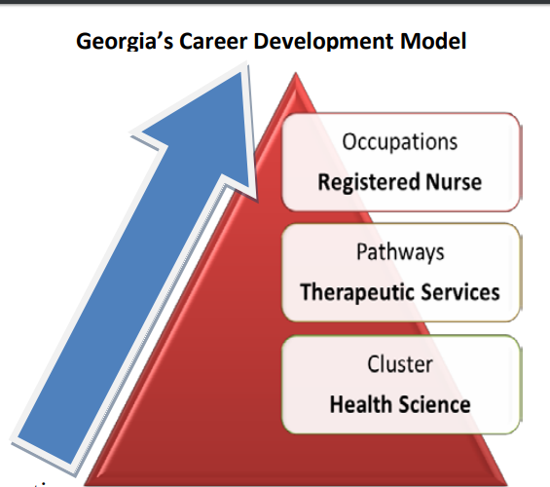
How are you going to get there?
Brandy K. Nicholson, LPC NCC RPT
School Counselor, HCES 2020

